Slide 1

Team Poop Calyber Game
Chuyun Deng, Emily Qiu

Slide 2
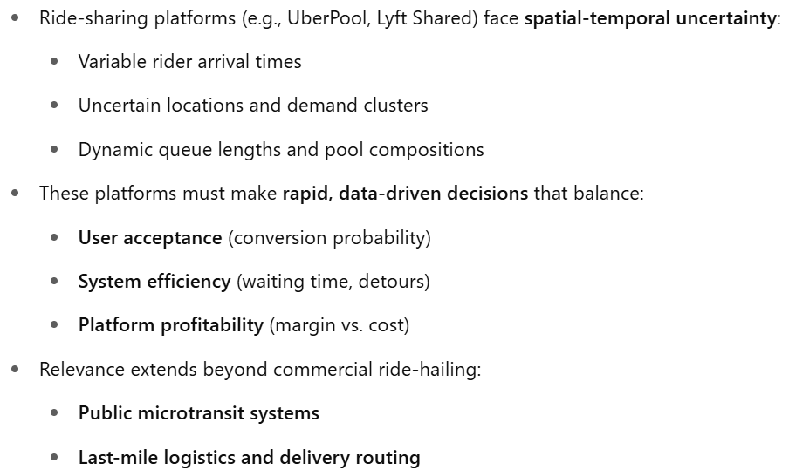
Motivation

Slide 3
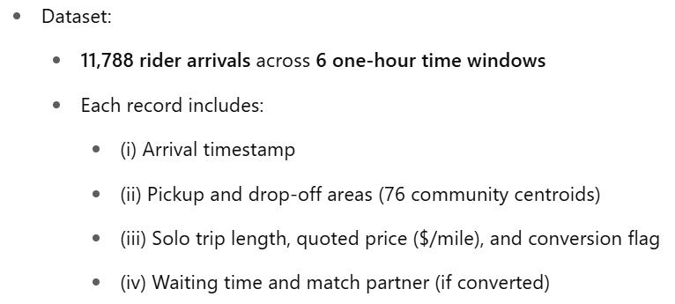
Motivation

Slide 4
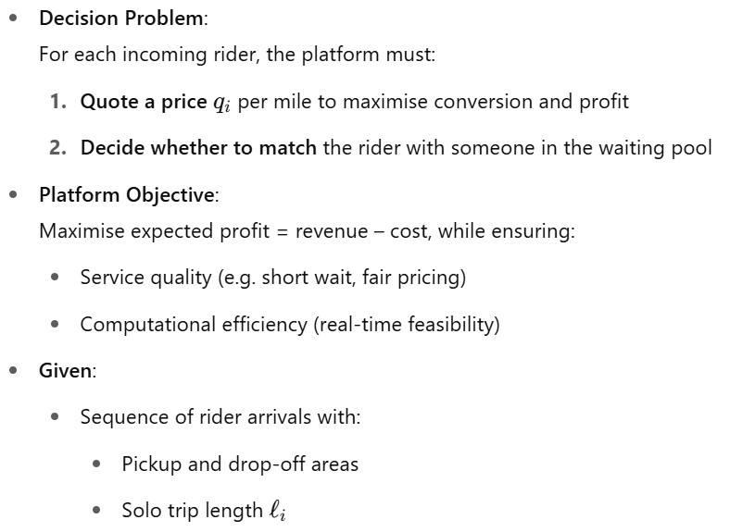
Problem Setting

Slide 5
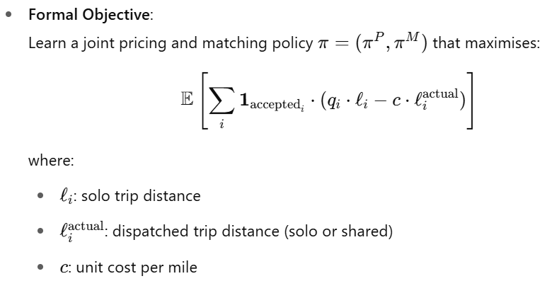
Problem Setting

Slide 6
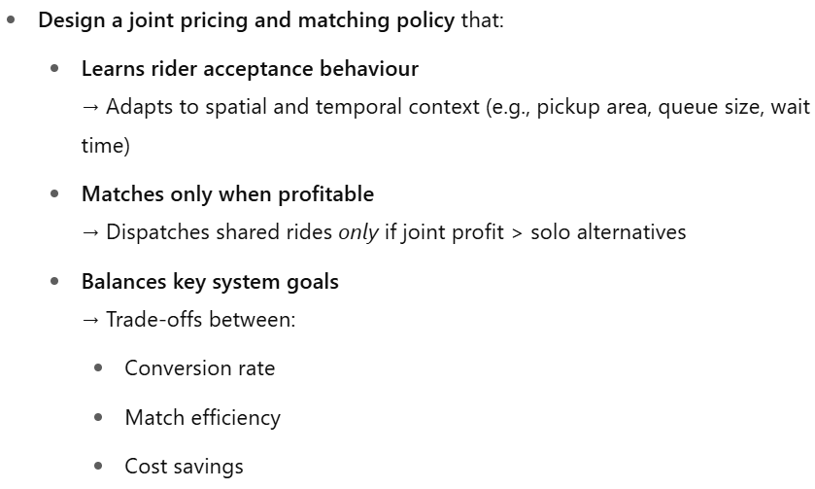
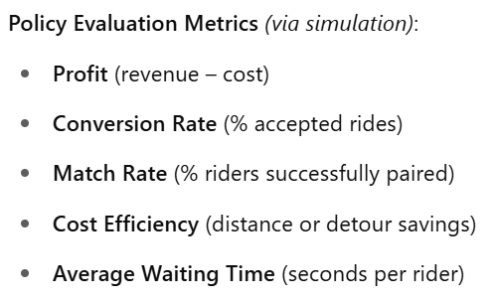
Project Objectives

Slide 7
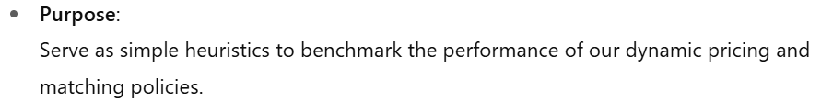
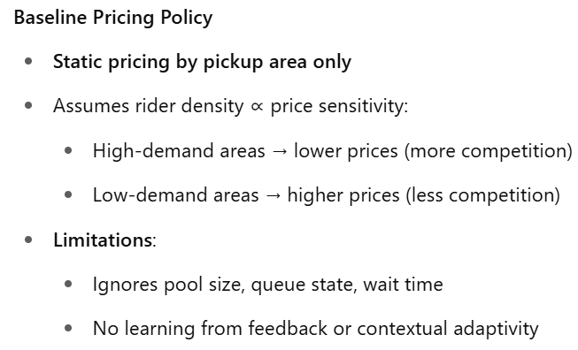
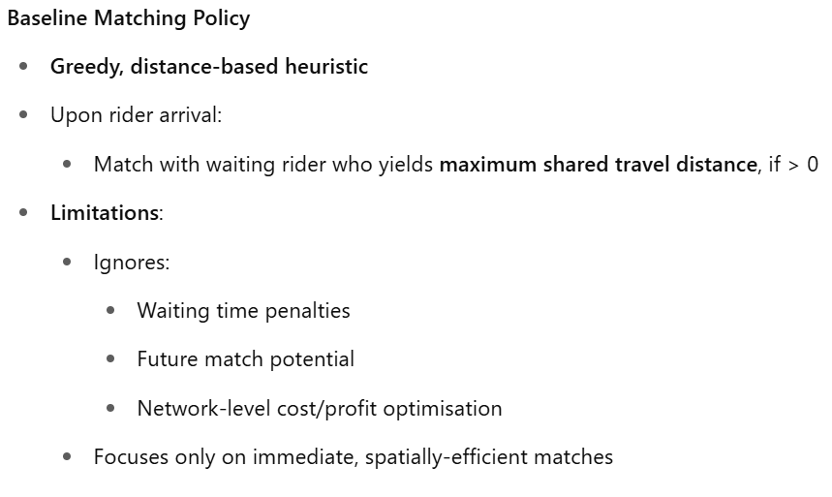
Baseline Policies

Slide 8

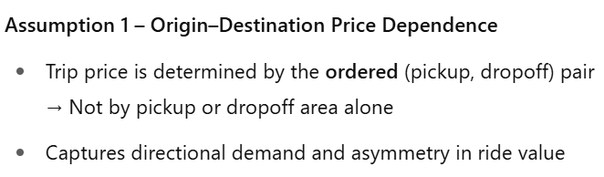
Pricing Policy Trials

Slide 9
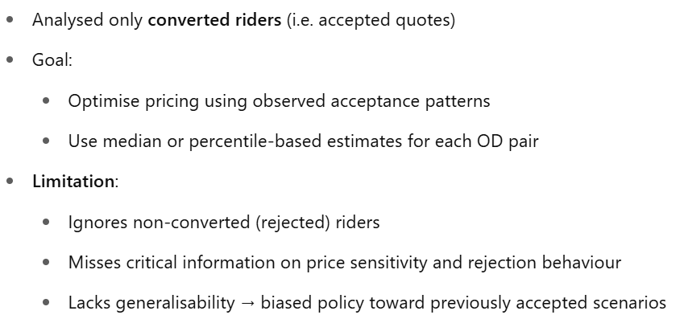
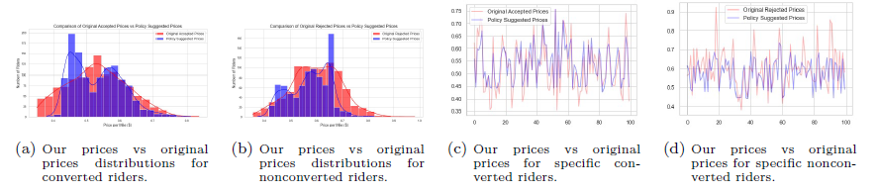
Average Price Pricing

Slide 10

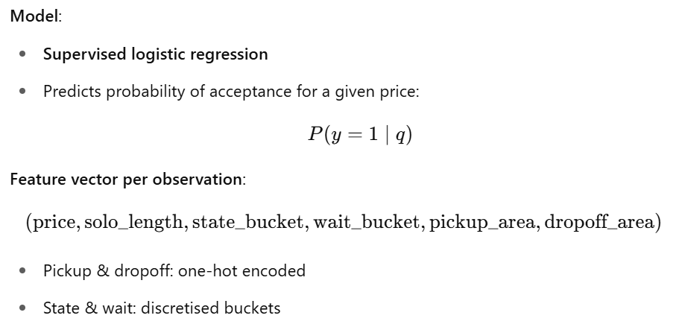
Logistic-Acceptance Classifier

Slide 11
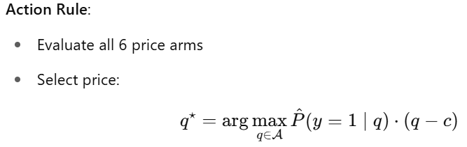
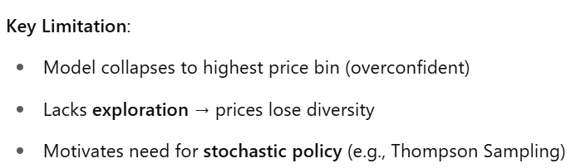
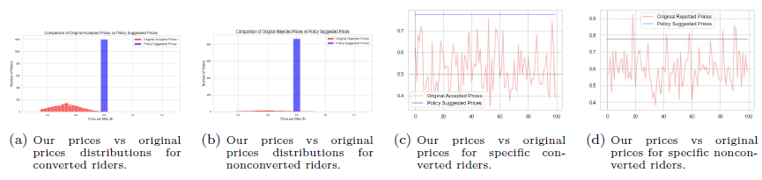
Logistic-Acceptance Classifier

Slide 12
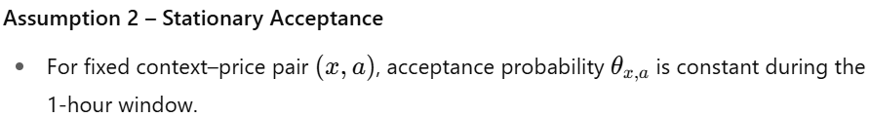
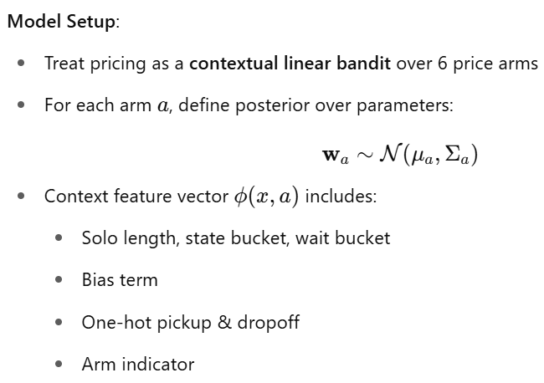
Linear Thompson Sampling

Slide 13
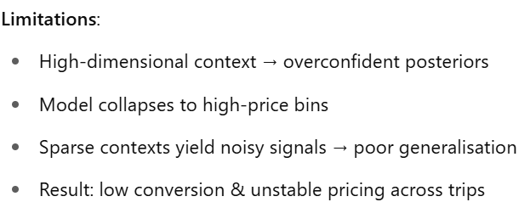
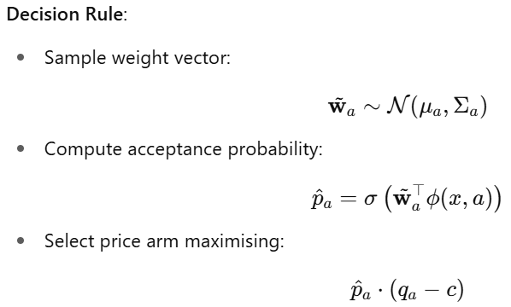
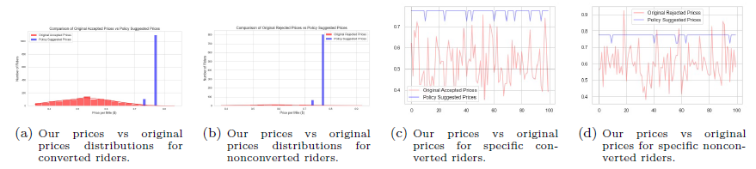
Linear Thompson Sampling

Slide 14
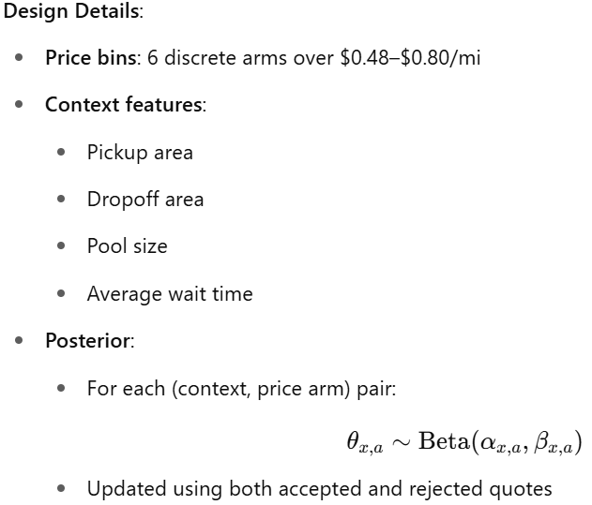
Contextual Beta-Bernoulli Thompson-sampling Bandit
The final pricing strategy adopted was a contextual Beta-Bernoulli Thompson sampler, selected after evaluating median pricing, logistic regression, and linear Thompson sampling approaches.
This strategy was preferred due to its stability, interpretability, and ability to operate efficiently in real time. It effectively balances exploration and exploitation, ensuring profitable decisions while adapting to diverse demand scenarios.
Crucially, it supports fallback generalisation, allowing the model to remain robust in sparse or unseen contexts by leveraging hierarchical priors across pickup, dropoff, and global levels.

Slide 15
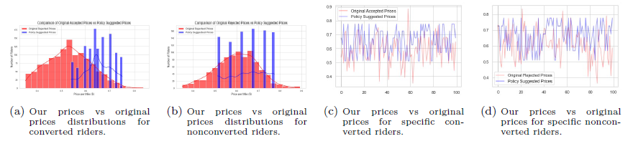
Contextual Beta-Bernoulli Thompson-sampling Bandit

Slide 16
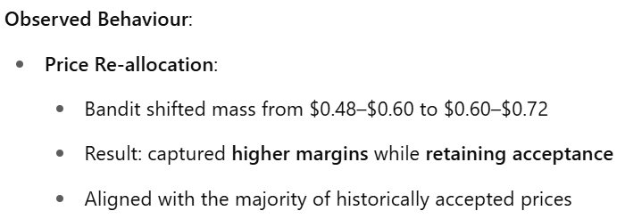
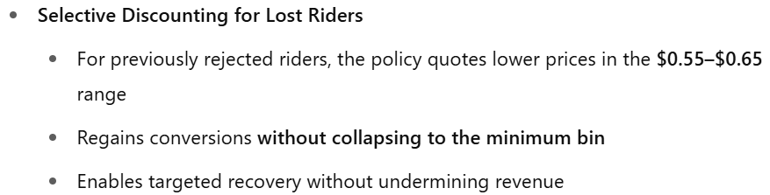
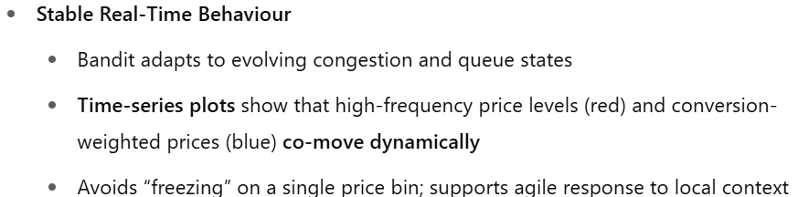
Contextual Beta-Bernoulli Thompson-sampling Bandit

Slide 17
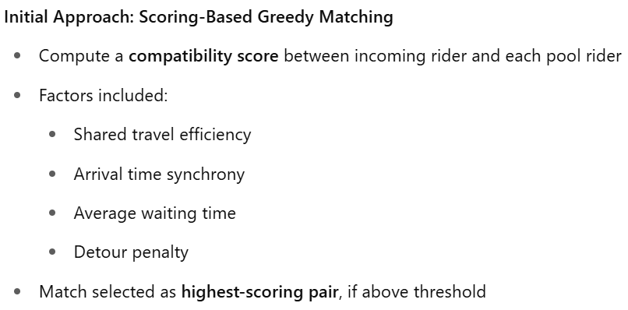
Motivation: Matching Policy

Slide 18
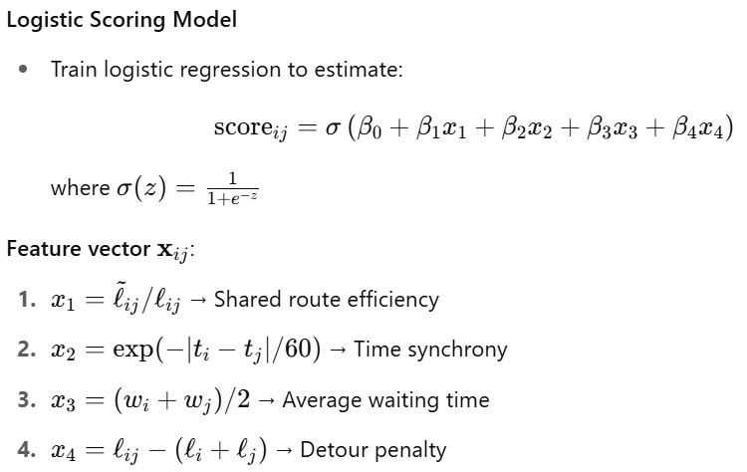
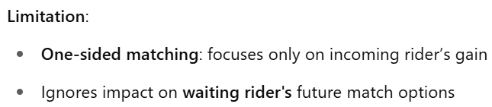
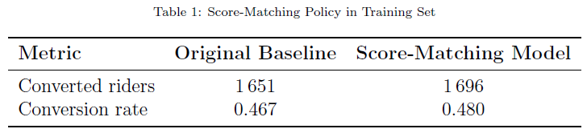
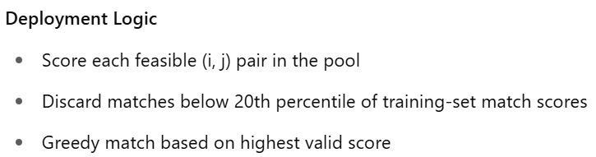
Motivation: Matching Policy

Slide 19
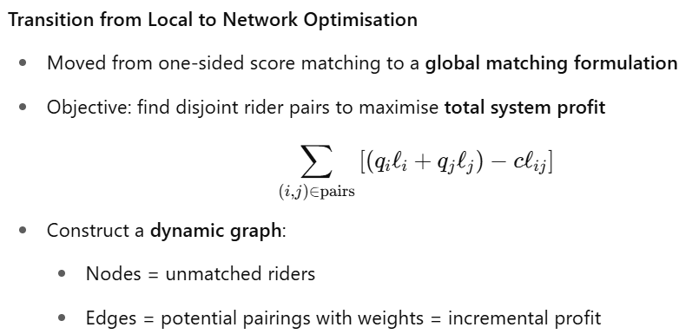
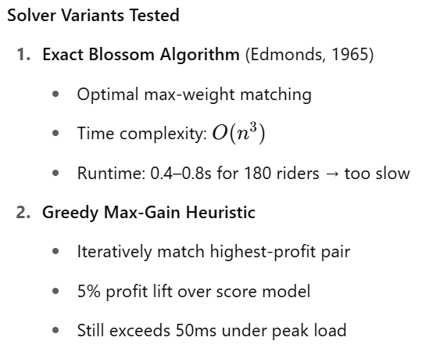
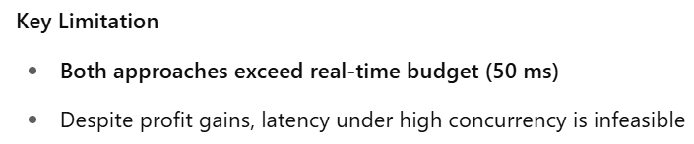
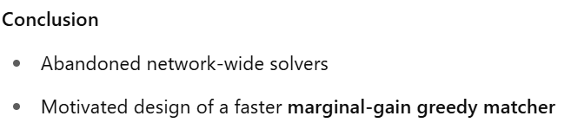
Network-Wide Matching

Slide 20
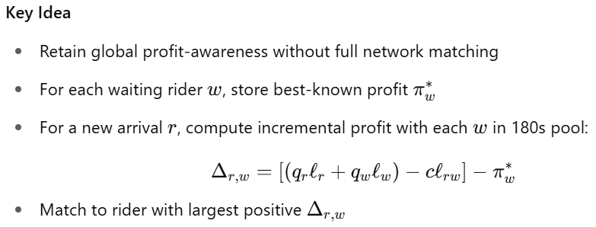
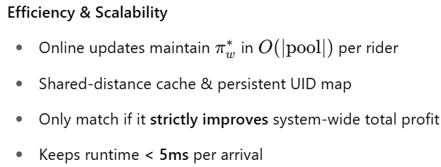
Marginal-Gain Greedy Matching

Slide 21
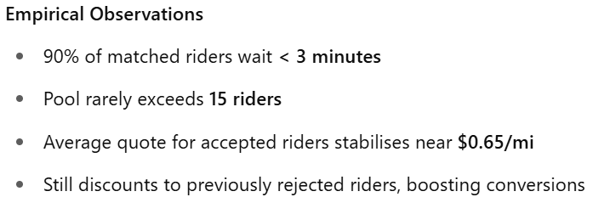
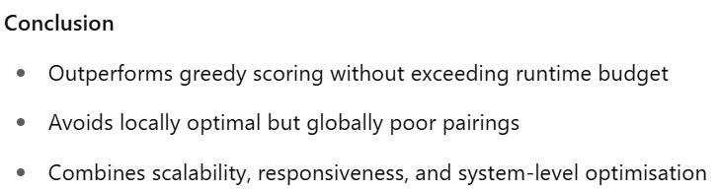
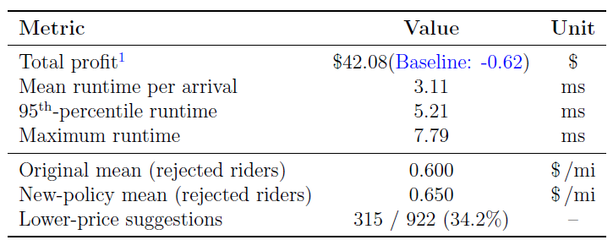
Marginal-Gain Greedy Matching

Slide 22
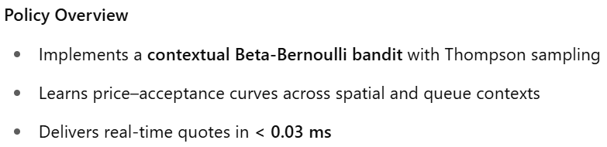
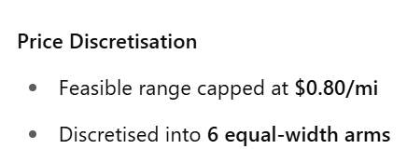
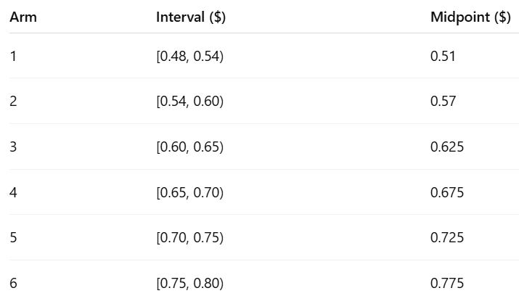
Implementation – Pricing policy

Slide 23
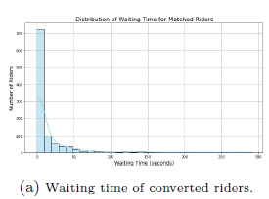
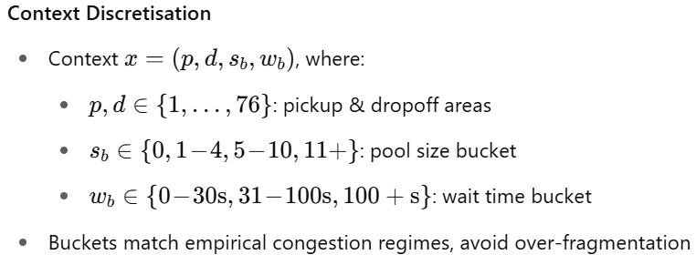
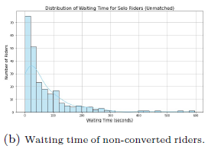
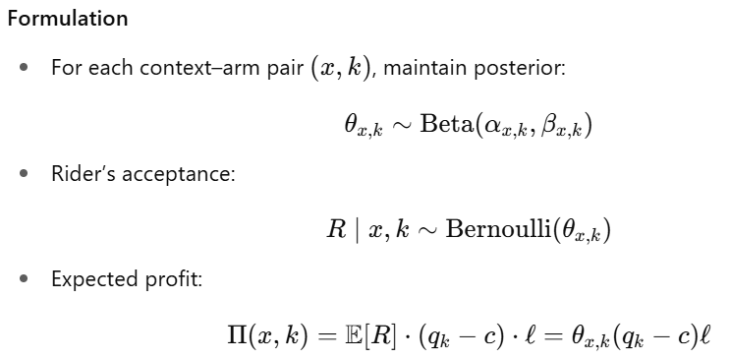
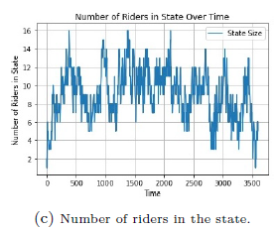
Implementation – Pricing policy

Slide 24
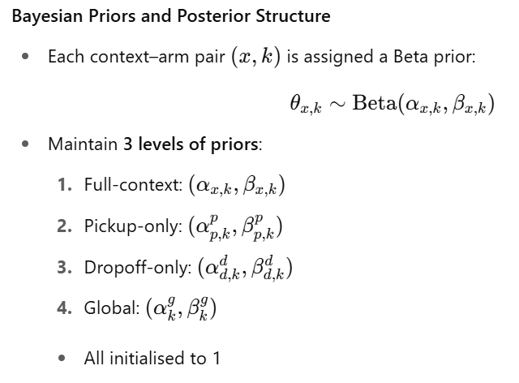
Implementation – Pricing policy

Slide 25
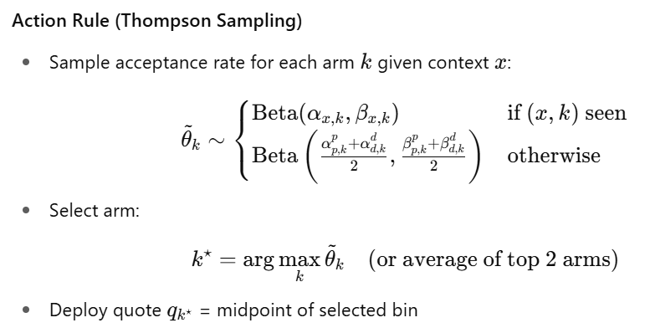

Implementation – Pricing policy

Slide 26

Implementation – Pricing policy

Slide 27



Implementation – Pricing policy

Slide 28

Implementation – Pricing policy

Slide 29

Implementation – Pricing policy

Slide 30


Implementation – Matching policy

Slide 31


Implementation – Matching policy

Slide 32


Implementation – Matching policy

Slide 33

Implementation – Matching policy

Slide 34

Implementation – Matching policy

Slide 35

Implementation – Matching policy

Slide 36

Implementation – Matching policy

Slide 37
Computational Results
Feature | Value | Insight
Profitability | $0.65/mi | Positive net margin, 68% revenue gain over baseline
Throughput | 12.5 req/min | Handles high arrival rate under real-time latency constraints
Conversion Rate | 43% | Context-aware pricing balances acceptance vs. margin
Matching Efficiency | 54% | Marginal-gain matcher yields net-positive pairings
Cost Management | +15% | Distance caps & detour < 8% of solo miles
Price Structure | $0.62/mi | Adaptive bandits reduce low-value quotes while preserving acceptance
Responsiveness | 56 sec avg | Median runtime 3 ms, 95th percentile under 5 ms (< 50 ms budget)

Slide 38

Computational Results

